Slide 1
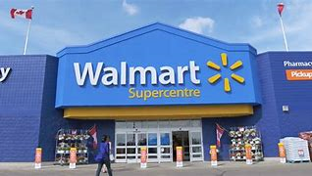
Sales Performance Analysis of Walmart Stores Using Advanced MySQL Techniques
RAHUL YADAV

Slide 2






OVERVIEW SLIDE
Company
Problem Statement
Some Updates In Dataset
Overview of the Company.
What we are facing and would like to overcome in the project.
Dataset is not up to date or well structed, like missing values, data type, etc
Tasks
Challenges
Conclusion
Different tasks that are facing in the problem statement.
Some challenges that we find during the project.
Business Impact and Improvements for further.

Slide 3
About Company
Walmart, a major retail chain, operates across several cities, offering a wide range of products. The dataset provided contains detailed transaction data, including customer demographics, product lines, sales figures, and payment methods. This project will use advanced SQL techniques to uncover actionable insights into sales performance, customer behavior, and operational efficiencies.
Introduction

Slide 4
Business Problem
20XX
Walmart wants to optimize its sales strategies by analyzing historical transaction data across branches, customer types, payment methods, and product lines. To achieve this, advanced MySQL queries will be employed to answer challenging business questions related to sales performance, customer segmentation, and product trends.

Slide 5
Some updates that are done in the dataset:
UPDATE
Adding a new column new_date because date column is text here:
ALTER TABLE walmartsales
ADD COLUMN new_date date
AFTER Total;
Update the added column:
UPDATE walmartsales
SET new_date = str_to_date(Date, '%d-%m-%Y’);
Delete the date column, because it is extra after creation of new_date column
ALTER TABLE walmartsales
DROP COLUMN Date;

Slide 6
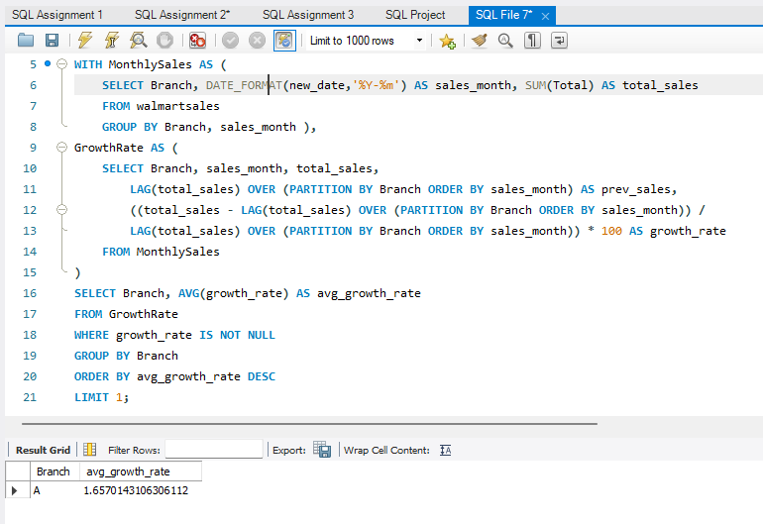
Identifying the Top Branch by Sales Growth Rate: Walmart wants to identify which branch has exhibited the highest sales growth over time. Analyze the total sales for each branch and compare the growth rate across months to find the top performer.
TASK
1
Output
WITH MonthlySales AS (
SELECT Branch, DATE_FORMAT(new_date,'%Y-%m') AS sales_month, SUM(Total) AS total_sales
FROM walmartsales
GROUP BY Branch, sales_month ),
GrowthRate AS (
SELECT Branch, sales_month, total_sales, LAG(total_sales) OVER (PARTITION BY Branch ORDER BY sales_month) AS prev_sales,
((total_sales - LAG(total_sales) OVER (PARTITION BY Branch ORDER BY sales_month)) /
LAG(total_sales) OVER (PARTITION BY Branch ORDER BY sales_month)) * 100 AS growth_rate
FROM MonthlySales)
SELECT Branch, AVG(growth_rate) AS avg_growth_rate
FROM GrowthRate
WHERE growth_rate IS NOT NULL
GROUP BY Branch
ORDER BY avg_growth_rate DESC
LIMIT 1;
SQL Query

Slide 7
Top Branch by Sales Growth Rate

Slide 8
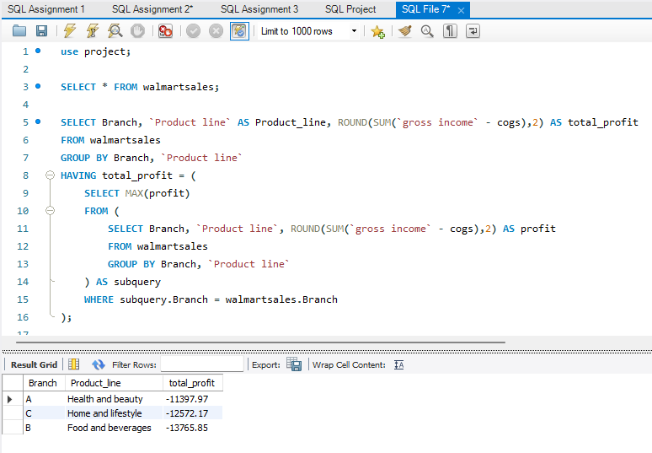
Finding the Most Profitable Product Line for Each Branch: Walmart needs to determine which product line contributes the highest profit to each branch. The profit margin should be calculated based on the difference between the gross income and cost of goods sold.
TASK
2
Output
SELECT Branch, `Product line` AS Product_line,
ROUND(SUM(`gross income` - cogs),2) AS total_profit
FROM walmartsales
GROUP BY Branch, `Product line`
HAVING total_profit = (SELECT MAX(profit)
FROM (SELECT Branch, `Product line`, ROUND(SUM(`gross
income` - cogs),2) AS profit
FROM walmartsales
GROUP BY Branch, `Product line` ) AS subquery
WHERE subquery.Branch = walmartsales.Branch);
SQL Query

Slide 9
Most Profitable Product Line for Each Branch

Slide 10
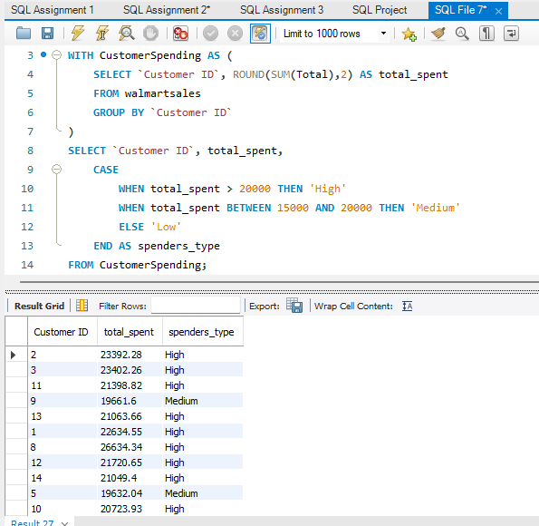
Analyzing Customer Segmentation Based on Spending: Walmart wants to segment customers based on their average spending behavior. Classify customers into three tiers: High, Medium, and Low spenders based on their total purchase amounts.
TASK
3
Output
WITH CustomerSpending AS (
SELECT `Customer ID`, ROUND(SUM(Total),2) AS total_spent
FROM walmartsales
GROUP BY `Customer ID`)
SELECT `Customer ID`, total_spent,
CASE
WHEN total_spent > 20000 THEN 'High'
WHEN total_spent BETWEEN 15000 AND 20000 THEN 'Medium’
ELSE 'Low' END AS spenders_type
FROM CustomerSpending;
SQL Query

Slide 11
Customer Segmentation Based on Spending

Slide 12
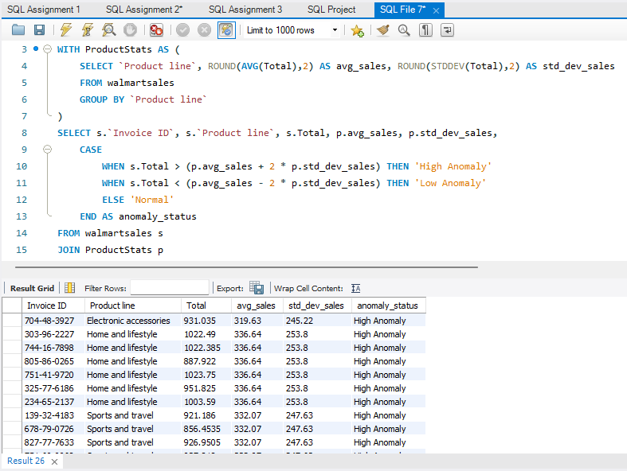
Detecting Anomalies in Sales Transactions: Walmart suspects that some transactions have unusually high or low sales compared to the average for the product line. Identify these anomalies.
TASK
4
Output
WITH ProductStats AS (
SELECT `Product line`, ROUND(AVG(Total),2) AS avg_sales, ROUND(STDDEV(Total),2) AS std_dev_sales
FROM walmartsales
GROUP BY `Product line`)
SELECT s.`Invoice ID`, s.`Product line`, s.Total, p.avg_sales, p.std_dev_sales,
CASE
WHEN s.Total > (p.avg_sales + 2 * p.std_dev_sales) THEN 'High Anomaly'
WHEN s.Total < (p.avg_sales - 2 * p.std_dev_sales) THEN 'Low Anomaly'
ELSE 'Normal' END AS anomaly_status
FROM walmartsales s JOIN ProductStats p
ON s.`Product line` = p.`Product line`
WHERE s.Total > (p.avg_sales + 2 * p.std_dev_sales)
OR
s.Total < (p.avg_sales - 2 * p.std_dev_sales);
SQL Query

Slide 13
Anomalies in Sales Transactions

Slide 14
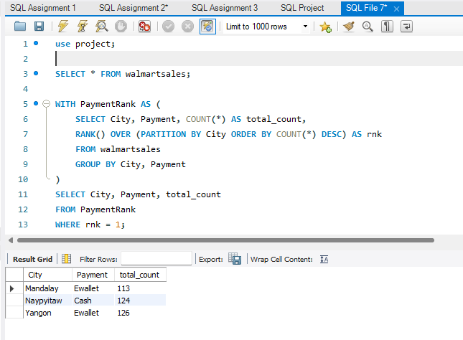
Most Popular Payment Method by City: Walmart needs to determine the most popular payment method in each city to tailor marketing strategies.
TASK
5
Output
WITH PaymentRank AS (
SELECT City, Payment, COUNT(*) AS total_count,
RANK() OVER (PARTITION BY City ORDER BY COUNT(*)
DESC) AS rnk
FROM walmartsales
GROUP BY City, Payment)
SELECT City, Payment, total_count
FROM PaymentRank
WHERE rnk = 1;
SQL Query

Slide 15
Most Popular Payment Method by City

Slide 16
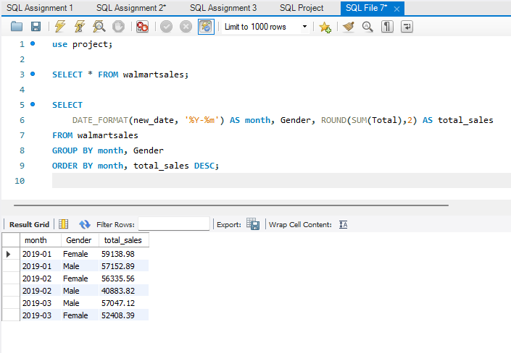
Monthly Sales Distribution by Gender: Walmart wants to understand the sales distribution between male and female customers on a monthly basis.
TASK
6
Output
SELECT
DATE_FORMAT(new_date, '%Y-%m') AS month, Gender,
ROUND(SUM(Total),2) AS total_sales
FROM walmartsales
GROUP BY month, Gender
ORDER BY month, total_sales DESC;
SQL Query

Slide 17
Monthly Sales Distribution by Gender

Slide 18
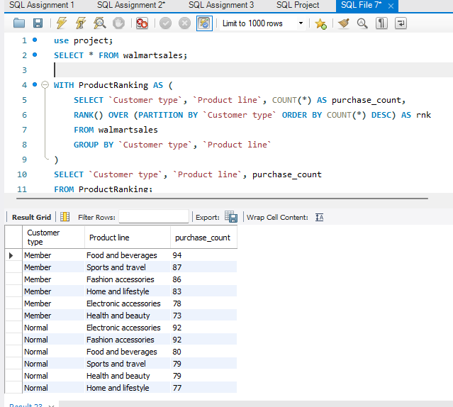
Best Product Line by Customer Type: Walmart wants to know which product lines are preferred by different customer types(Member vs. Normal).
TASK
7
Output
WITH ProductRanking AS (
SELECT `Customer type`, `Product line`, COUNT(*) AS
purchase_count,
RANK() OVER (PARTITION BY `Customer type` ORDER BY
COUNT(*) DESC) AS rnk
FROM walmartsales
GROUP BY `Customer type`, `Product line`)
SELECT `Customer type`, `Product line`, purchase_count
FROM ProductRanking;
SQL Query

Slide 19
Best Product Line by Customer Type

Slide 20
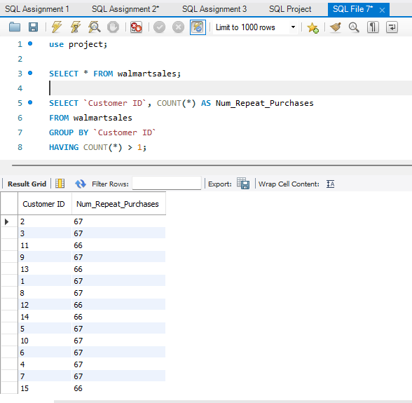
Identifying Repeat Customers: Walmart needs to identify customers who made repeat purchases within a specific time frame (e.g., within 30 days).
TASK
8
Output
SELECT
`Customer ID`,
COUNT(*) AS Num_Repeat_Purchases
FROM walmartsales
GROUP BY `Customer ID`
HAVING COUNT(*) > 1;
SQL Query

Slide 21
Repeat Customers

Slide 22
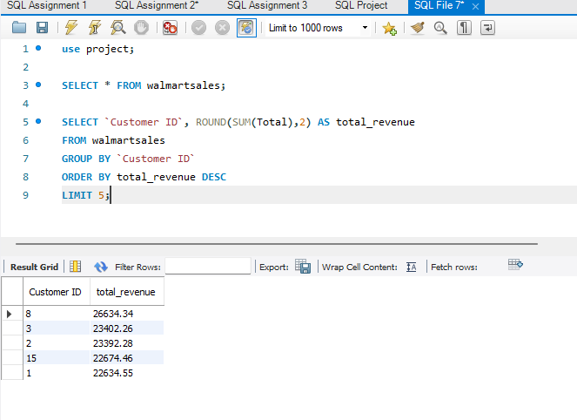
Finding Top 5 Customers by Sales Volume: Walmart wants to reward its top 5 customers who have generated the most sales Revenue.
TASK
9
Output
SELECT
`Customer ID`,
ROUND(SUM(Total),2) AS total_revenue
FROM walmartsales
GROUP BY `Customer ID`
ORDER BY total_revenue DESC
LIMIT 5;
SQL Query

Slide 23
Top 5 Customers by Sales Volume

Slide 24
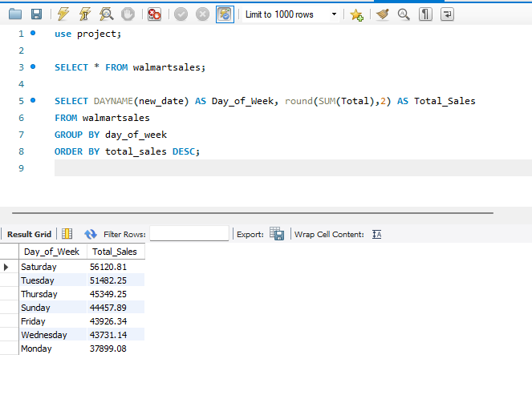
Analyzing Sales Trends by Day of the Week: Walmart wants to analyze the sales patterns to determine which day of the week brings the highest sales.
TASK
10
Output
SELECT
DAYNAME(new_date) AS Day_of_Week,
Round(SUM(Total),2) AS Total_Sales
FROM walmartsales
GROUP BY day_of_week
ORDER BY total_sales DESC;
SQL Query

Slide 25
Analyzing Sales Trends by Day of the Week

Slide 26
Challenges Faced During the Project
Data Formatting Issues:
The date column was stored as a string, requiring conversion for analysis.
Missing or Incomplete Data:
Some records had missing values, affecting accuracy.
Query Optimization:
Complex queries (e.g., using LAG, RANK) required performance tuning.
Handling Large Datasets:
Processing large transaction data led to performance bottlenecks.
Understanding Business Context:
Ensuring that SQL insights aligned with business objectives.
Visualization Challenges:
Exporting SQL results and creating meaningful charts for presentation.
Limited Function Support in MySQL Version:
Some date-related functions were not working due to version constraints.

Slide 27
Conclusion
Business Impact:
Optimized product placement and branch operations based on sales performance.
Personalized customer engagement strategies to improve retention.
Strengthened fraud detection measures to minimize revenue loss.
Enhanced marketing effectiveness with data-driven payment and demographic insights.
Recommendations for Future Improvements:
Implement AI-based predictive analytics for sales forecasting.
Introduce loyalty programs for repeat customers to boost engagement.
Enhance stock management based on peak sales trends.
Optimize online and offline payment incentives to drive more transactions.

Slide 28
Video Explaining of Project:
Link to Video
https://drive.google.com/file/d/1w4PQwx02I8abka9X_T2nQOH6tJ9HNamr/view

Slide 29

THANK YOU!
Rahul Yadav

